Slide 1
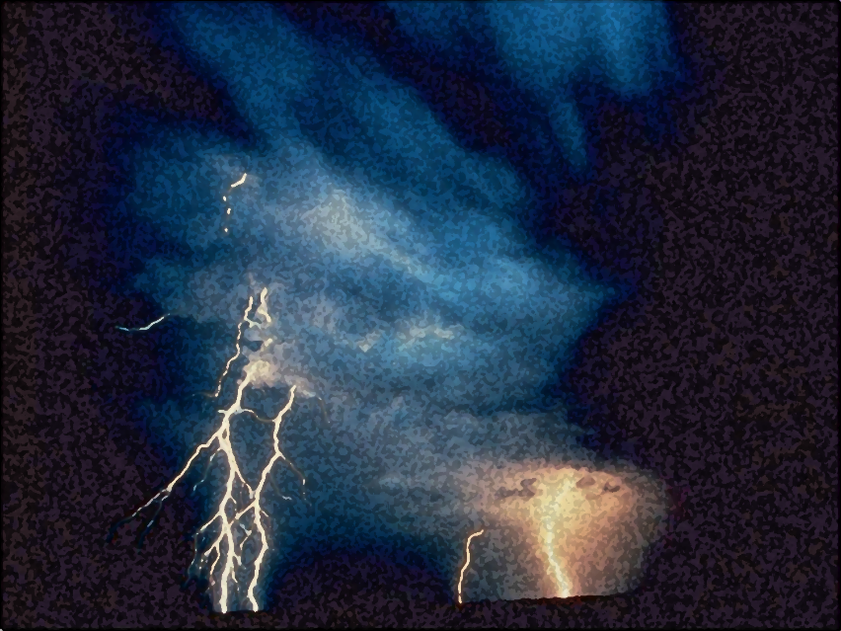
A Call to Servanthood
The Vision of Isaiah
Doom to Bloom

Slide 2
Theme and Purpose
How to become a useful, faithful and righteous servant of God.
A Call to Servanthood
How does sinful Israel become servant Israel?

Slide 3
Theme and Purpose
The entire book is an appeal to abandon human pride, to trust in the LORD, accept His lordship, and to experience all of life as it was originally meant to be - a reflection of God’s holy image and the role of a servant upon the earth.

Slide 4
The Vision of Isaiah
Introduction:
The Present and Future of God’s People
1:1 – 5:30

Slide 5
The Vision of Isaiah
Chapters 1-5 are a powerful, though general statement of the hopes and realities of Judah’s situation. The section moves back and forth between the two themes of doom and deliverance.

Slide 6
The Vision of Isaiah
Chapter 1
Introduces the Introduction
“…in a very succinct way chapter 1 details Judah’s situation in God’s sight and calls them to Him” (p. 54)
“The Grand Arraignment”

Slide 7
Chapter 1
Sets the Stage for What Follows
Declares the inevitable destructive results of forsaking God
The foolishness of rote religion
The necessity of justice
The corruption of leadership
Through it all the possibility of redemption, return and restoration.

Slide 8
Listen, Learn, and Live
God’s Denunciation, Plea, and Promise
1:2-31

Slide 9
Listen, Learn, and Live
Denunciation – 1:2-9
God’s charge against Israel: She has forsaken the LORD and is as a result, broken and desolate.

Slide 10
Listen, Learn, and Live
Plea – 1:10-20
God’s plea for Israel to hear, receive instruction, and to take the only reasonable action: obedience and submission.

Slide 11
Listen, Learn, and Live
“If you are willing and obedient, you shall eat the good of the land; But if you refuse and rebel, you shall be devoured by the sword’; For the mouth of the LORD has spoken.” (1:19-20)
Ignore, Ignorance, and Death

Slide 12
Listen, Learn, and Live
Promise – 1:21-31
God’s promise of judgment (death) for rebels and sinners, or redemption (life) for repentant ones.

Slide 13
Listen, Learn, and Live
God’s Response to Present Realities
1:21-31

Slide 14
Listen, Learn, and Live
Promise – 1:21-31
Isaiah turns to discuss the present condition of the nation and what God’s responds
will be.

Slide 15
Listen, Learn, and Live
Promise – 1:21-31
Israel's condition is so bad that destruction is inevitable.
Destruction is not God’s final purpose, but blessing through purification.

Slide 16
Listen, Learn, and Live
Promise – 1:21-31
God will avenge Himself against His enemies (24), and His own people is the enemy, but in order to redeem them.

Slide 17
Listen, Learn, and Live
Promise – 1:21-31
His purpose for the nation is ultimately beneficial.
The individuals who insist on rebellion and ignorance, destruction is all they will know.

Slide 18
Listen, Learn, and Live
The Announcement of Judgment
1:21-26
The Fate of the Wicked
1:27-31

Slide 19
Listen, Learn, and Live
The Announcement of Judgment
1:21-26
Takes the form of
classic judgment speech

Slide 20
Listen, Learn, and Live
The Announcement of Judgment
1:21-26
Takes the form of
prophetic judgment

Slide 21
Listen, Learn, and Live
1:21-26
Verse 21-23 gives the reason for the judgment.
Forsaking the LORD, by turning to idols.

Slide 22
Listen, Learn, and Live
1:21-26
Verse 24-26 is the announcement of judgment on the nation, which comes through intervention,
an intervention
with beneficial results.

Slide 23
Listen, Learn, and Live
1:21-26
The expected natural result would be
annihilation, extermination.

Slide 24
Listen, Learn, and Live
Mark 13:20
“And unless the Lord had shortened those days, no flesh would be saved; but for the elect's sake, whom He chose, He shortened the days.”

Slide 25
Listen, Learn, and Live
1:21-26
“But, in fact, the intended result is purification and reinstatement.” (Oswalt, p. 104)

Slide 26
Listen, Learn, and Live
1:21-23
Israel’s Current Condition
The Reason for her Judgment

Slide 27
Listen, Learn, and Live
“How the faithful city has become a harlot! It was full of justice; Righteousness lodged in it, but now murderers.”(1:21)
Jerusalem here is representative of the whole nation.

Slide 28
Listen, Learn, and Live
“How the faithful city has become a harlot! It was full of justice; Righteousness lodged in it, but now murderers.”(1:21)
Israel’s condition is described as a prostitute, who deserted the LORD for other lovers.

Slide 29
Listen, Learn, and Live
“How the faithful city has become a harlot! It was full of justice; Righteousness lodged in it, but now murderers.”(1:21)
A Actual Past – David/ Solomon
A Idealic or Angelic Past

Slide 30
Listen, Learn, and Live
“How the faithful city has become a harlot! It was full of justice; Righteousness lodged in it, but now murderers.”(1:21)
Those who remain faithful embody the principles of justice and righteousness because of their relation to the One who is righteousness and justice.

Slide 31
Listen, Learn, and Live
“Your princes are rebellious, and companions of thieves; Everyone loves bribes, and follows after rewards. They do not defend the fatherless, nor does the cause of the widow come before them.” (1:22-23)

Slide 32
Listen, Learn, and Live
The ruling class, “the elite”, has become perverted so that those who are to promote order and obedience are themselves rebels.
The nation has prostituted itself with other gods and the leadership has become trash.

Slide 33
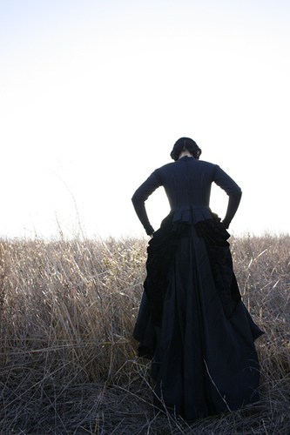
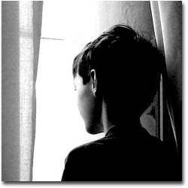
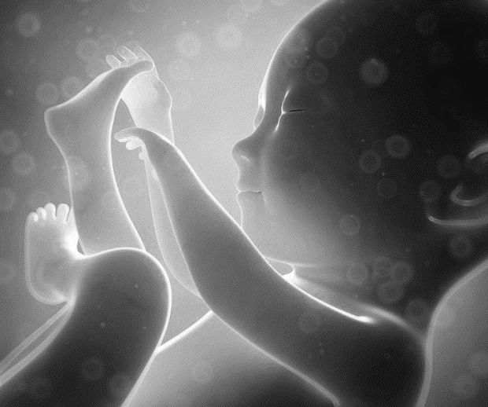
Listen, Learn, and Live
Isaiah, as other prophets, often makes the connection between idolatry and social justice.

Slide 34
Listen, Learn, and Live
“Therefore the Lord (Adonai) says, the LORD (Yahweh) of hosts, the Mighty One of Israel, ‘Ah, I will rid Myself of My adversaries, and take vengeance on My enemies.” (1:24)

Slide 35
Listen, Learn, and Live
Adonai – Sovereign, Master (-)
Yahweh – “I Am”
The combined effect is complete mastery, total dominance.
The LORD Hosts – “vast army”
The Mighty One of Israel (+)

Slide 36
Listen, Learn, and Live
“But He who is mighty to save can also be mighty to destroy, all the more so because the enemy is His own people.” (p. 106)
“For the time has come for judgment to begin at the house of God…” (1 Peter 4:17)

Slide 37
Listen, Learn, and Live
“And again, ‘The LORD will judge His people. It is a fearful thing to fall into the hands of the living God.” (Hebrews 10:30b-31)

Slide 38
Listen, Learn, and Live
‘Ah, I will rid Myself of My adversaries, and take vengeance on My enemies.” (1:24b)
Judgment Announced
“Woe”

Slide 39
Listen, Learn, and Live
‘Ah, I will rid Myself of My adversaries, and take vengeance on My enemies.” (1:24b)
God’s children are those who do His will, whoever they be, (56) while those who rebel are His enemies, though they be Israel (57)

Slide 40
Listen, Learn, and Live
‘Peace, peace to him who is far off and to him who is near,’ Says the LORD,’ And I will heal him.’ But the wicked are like the troubled sea, When it cannot rest, whose waters cast up mire and dirt. ‘There is no peace,’ Says my God, ‘for the wicked.” (57:19-21)

Slide 41
Listen, Learn, and Live
“I will turn My hand against you, and thoroughly purge away your dross, and take away all your alloy. (1:25)
After a time of abandonment of His own people the Lord will put His hand again for purification.

Slide 42
Listen, Learn, and Live
“I will turn My hand against you, and thoroughly purge away your dross, and take away all your alloy. (1:25)
God’s hand will not be upon them to completely destroy them, but to restore them.

Slide 43
Listen, Learn, and Live
“I will restore your judges as at the first, and your counselors as at the beginning. (1:25-26a)
Israel needs just, impartial rulership which will govern out of a sense of responsibility, rather than greed.

Slide 44
Listen, Learn, and Live
“Afterward you shall be called the city of righteousness, the faithful city.” (1:26b)
Israel will be restored to the vision of what she is called to be, after having passed as through fire.

Slide 45
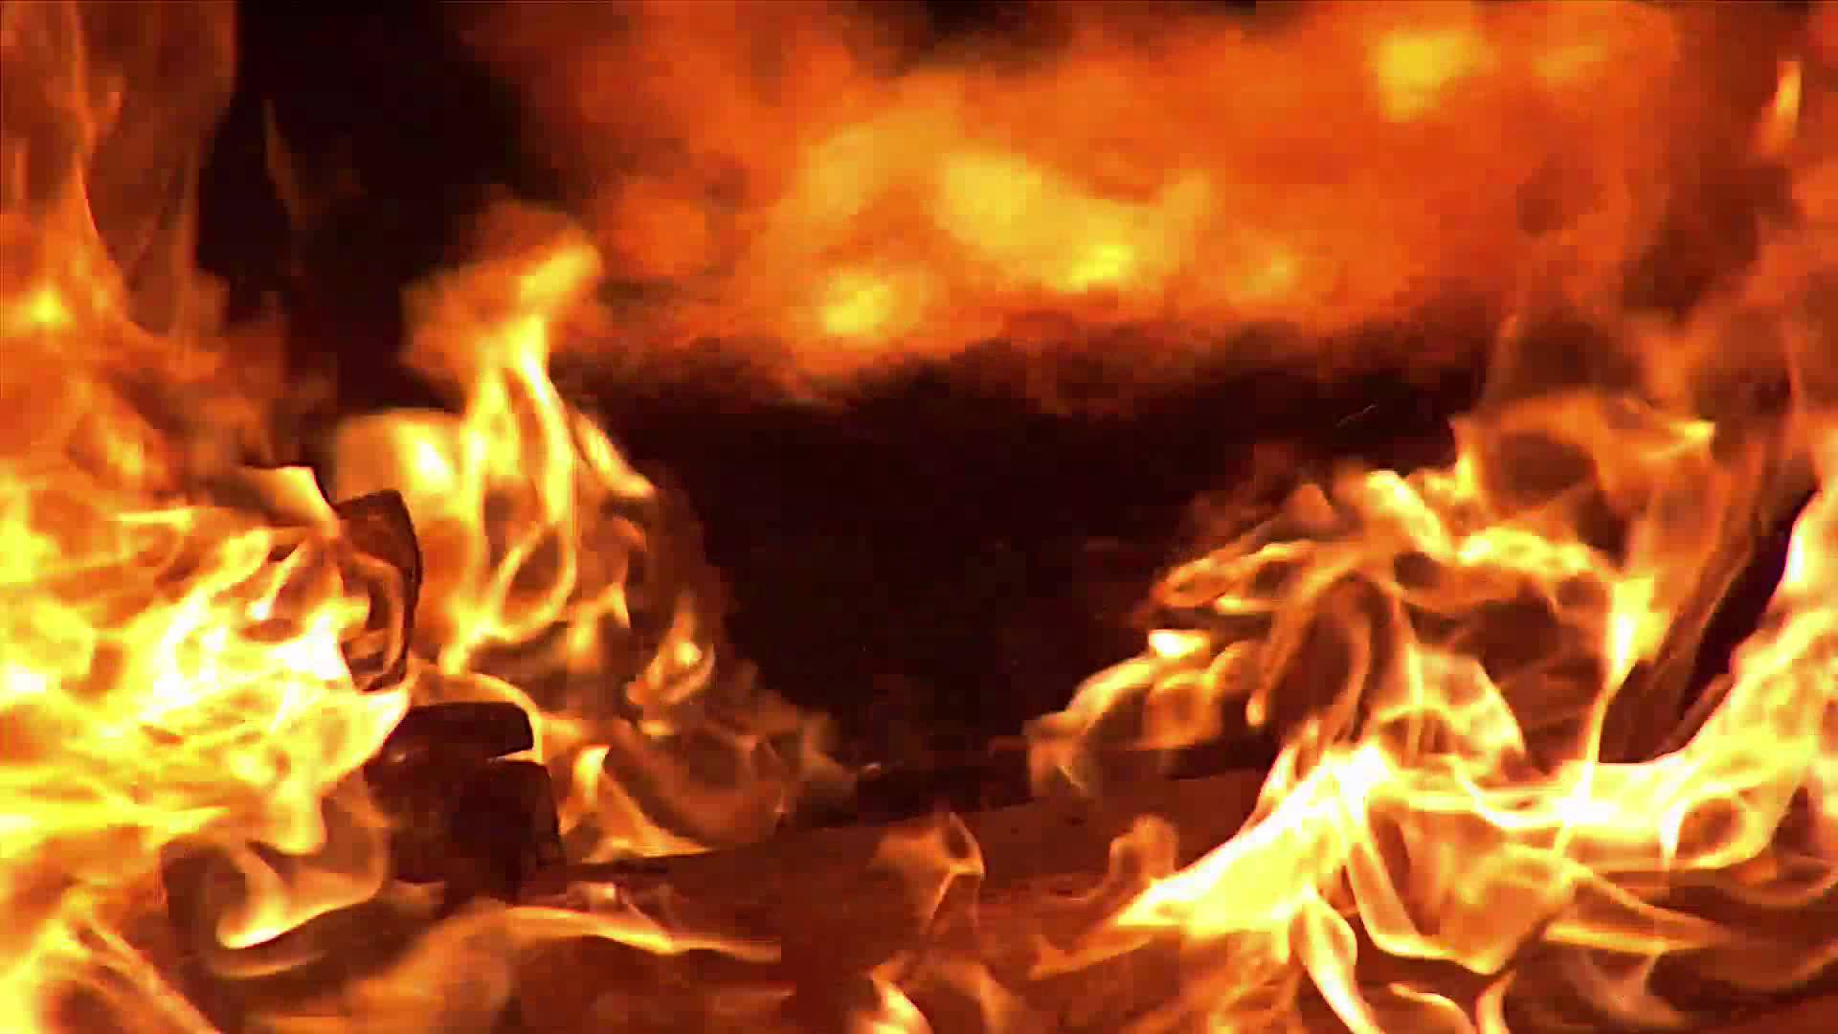
Listen, Learn, and Live
The Fate of the Wicked
1:27-31

Slide 46
Listen, Learn, and Live
This section (1:27-30) concludes the introduction to the introduction (chapters 2-5).
It is similar to the conclusion to the longer introduction (5:24-30), and to the concluding verse of the book (66:24)

Slide 47
Listen, Learn, and Live
The point to note is this:
Continued arrogant rebellion against God will result in destruction.
The mighty will perish, their judgment is sure.

Slide 48
Listen, Learn, and Live
“Zion shall be redeemed with justice, and her penitents with righteousness.” (1:27)
A transitional verses between the purification for the repentant ones and destruction for the rebellious.

Slide 49
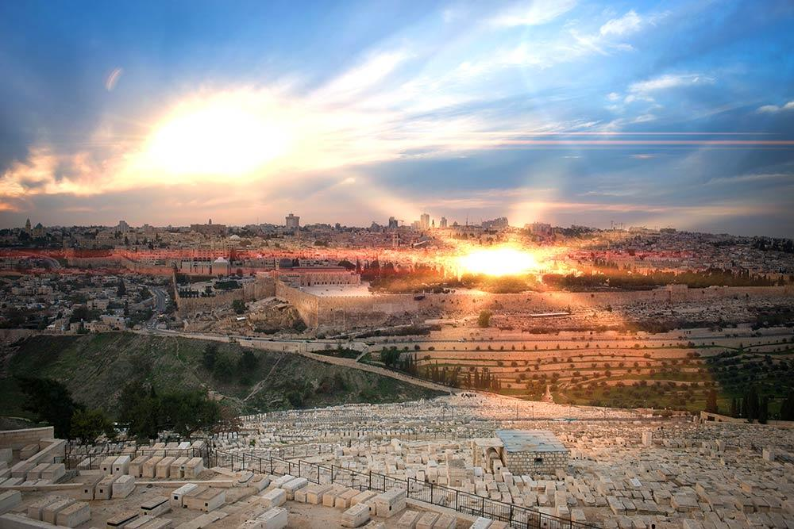
Listen, Learn, and Live
“Zion shall be redeemed with justice, and her penitents with righteousness.” (1:27)
Zion is a favorite of Isaiah occurring 47x’s.

Slide 50
Listen, Learn, and Live
“Zion shall be redeemed with justice, and her penitents with righteousness.” (1:27)
Zion depicts choosiness, hope and beauty, for
those who belong
to God.

Slide 51
Listen, Learn, and Live
“Zion shall be redeemed with justice, and her penitents with righteousness.” (1:27)
The imagery is double effective when Zion is said
to be desolate and
destroyed.

Slide 52
Listen, Learn, and Live
“Zion shall be redeemed with justice, and her penitents with righteousness.” (1:27)
Zion is to be redeemed, as a gift from God, her
desolation and
destruction is passing.

Slide 53
Listen, Learn, and Live
“Zion shall be redeemed with justice, and her penitents with righteousness.” (1:27)
The use of redeemed suggests the chapter consciously introduces the entire book, but much more prominent in chs. 40-66.

Slide 54
Listen, Learn, and Live
“Zion shall be redeemed with justice, and her penitents with righteousness.” (1:27)
What is the source all righteousness and justice?
Is it not though His gracious gift?

Slide 55
Listen, Learn, and Live
“Zion shall be redeemed with justice, and her penitents with righteousness.” (1:27)
Those who depose themselves toward righteousness and justice, will be saved, and those who do not are destroyed.

Slide 56
Listen, Learn, and Live
“Keep justice, and do righteousness, for My salvation is about to come, and My righteousness to be revealed.” (56:1)
As humanity chooses to do what God makes possible, restoration and redemption occurs.

Slide 57
Listen, Learn, and Live
“The destruction of transgressors and of sinners shall be together, and those who forsake the LORD shall be consumed.” (1:28)
Those who refuse what God makes possible find only death and destruction.

Slide 58
Listen, Learn, and Live
“For they shall be ashamed of the terebinth (oak) trees which you have desired; And you shall be embarrassed because of the gardens which you have chosen. For you shall be as a oak whose leaf fades, and as a garden that has no water.” (1:29-30)

Slide 59
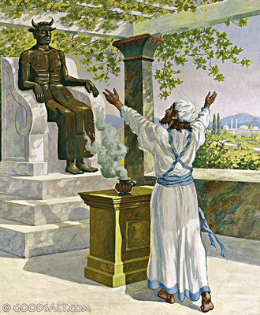
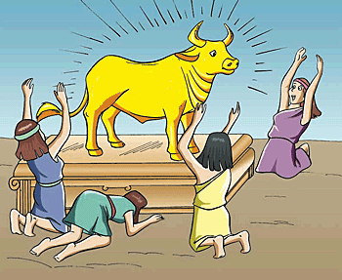
Listen, Learn, and Live
These verses make plain that it is the worship of idols to which “rebellion” and “forsaking God” referred.

Slide 60
Listen, Learn, and Live
“I will utter My judgments against them concerning all their wickedness, because they have forsaken Me, burned incense to other gods, and worshiped the works of their own hands.” (Jeremiah 1:16)

Slide 61
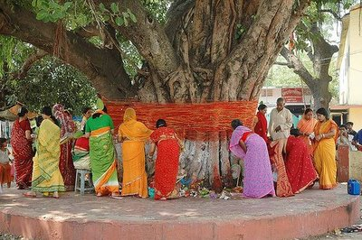
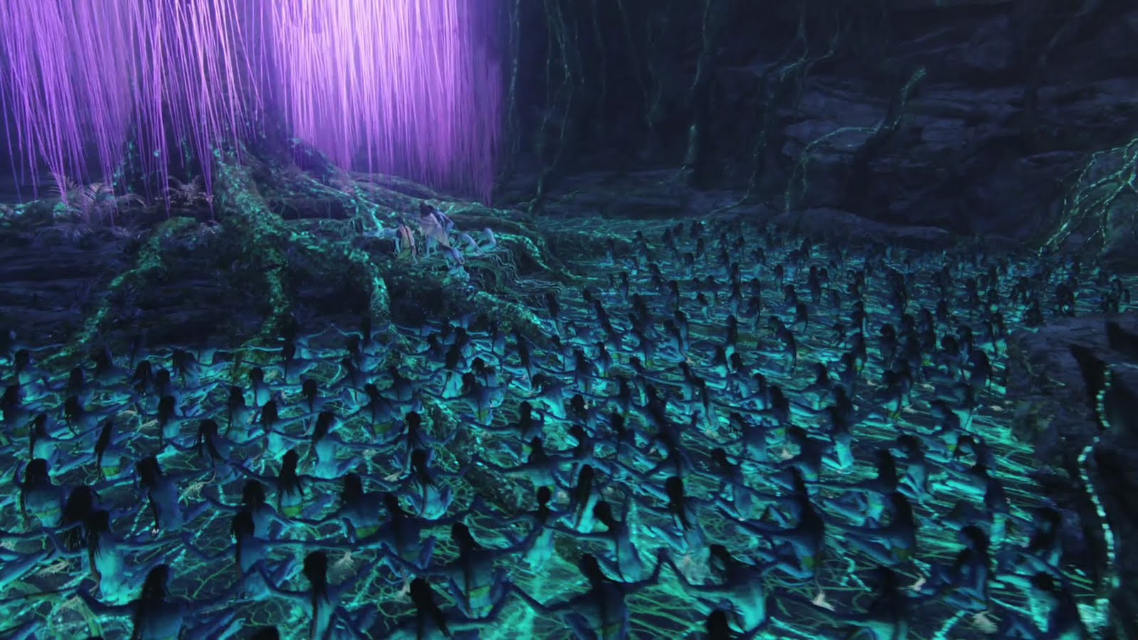
Listen, Learn, and Live
The use of “oaks” refers to sacred groves and gardens which were a part of the fertility cult of Baal and Ashtoreth.
Avatar

Slide 62
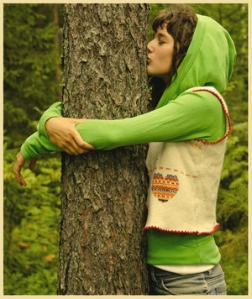
Listen, Learn, and Live
“To leave God who made the trees in order to worship the trees is the height of folly. To put trust in the creation is to have that trust betrayed.”

Slide 63
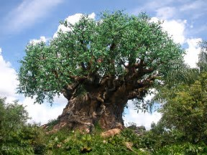
Listen, Learn, and Live
“How foolish then when God has chosen Judah, that Judah has chosen a tree.”
Tree of Life

Slide 64
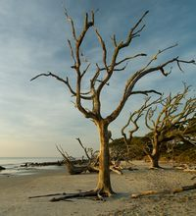
Listen, Learn, and Live
“The creation is not the source of life; the gods have no creative power in themselves. Thus those who depend upon the creation are doomed to wither and dry up.”

Slide 65
Listen, Learn, and Live
“Thus chose the garden and there is no water, chose the One who made the garden and there is streams of living water.” (Oswalt, p. 111)

Slide 66
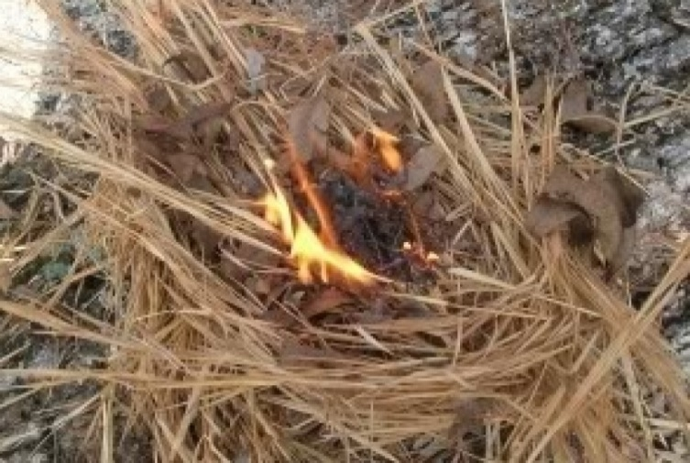
Listen, Learn, and Live
“The strong shall be as tinder, and the work of it as a spark; Both will burn together, and no one shall quench them.” (1:31)

Slide 67
Listen, Learn, and Live
The mighty of the earth, who worship some mighty tree, will be stripped bare, revealing that they were not mighty after all. They are chaff, good for nothing, but burning.

Slide 68
The Vision of Isaiah
Conclusion

Slide 69
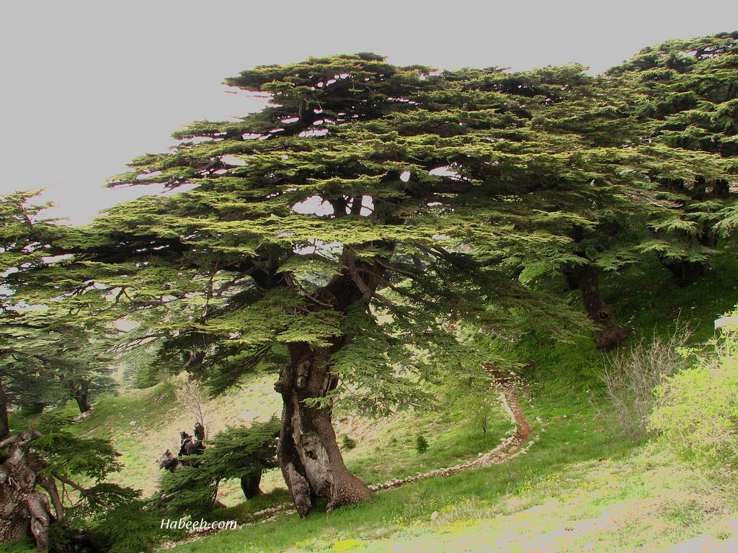
Listen, Learn, and Live
“God promises that Israel will be as glorious as Lebanon and Carmel…”

Slide 70
Listen, Learn, and Live
“He does not destroy the forest of human pride to leave a field of stumps. Rather the destruction is in order that the true glory of humanity, derived from the LORD, may appear.” (Oswalt, p. 111)

Slide 71
Listen, Learn, and Live
“For as the new heavens and the new earth which I will make shall remain before Me,’ says the LORD, ‘So shall your descendants and your name remain. And it shall come to pass… all flesh shall come to worship before Me,’ says the LORD.” (Isa 66:22-23 )

